Slide 1
Evaluation approaches under Covid-19: what have we learned
DeGEval Conference
Jos Vaessen, PhD
September 17, 2021

Slide 2
Outline
Introduction: three types of challenges
Methodological challenges: what did we do differently
Going forward: what have we learned

Slide 3
Three types of challenges
Work program challenges
Conceptual challenges
Methodological challenges

Slide 4
Methodological challenges
Difficult access to key informants:
Travel restrictions
Connectivity issues
Shifting institutional priorities
“Crisis” modus
Impossibility to conduct “on-site” data collection:
Difficulty to develop a rich and contextualized perspective on the evaluand
Strategies such as building rapport, unobtrusive observation, “on-the ground” snowball sampling of interviewees, are impossible
Remote interviewing is prone to biases

Slide 5
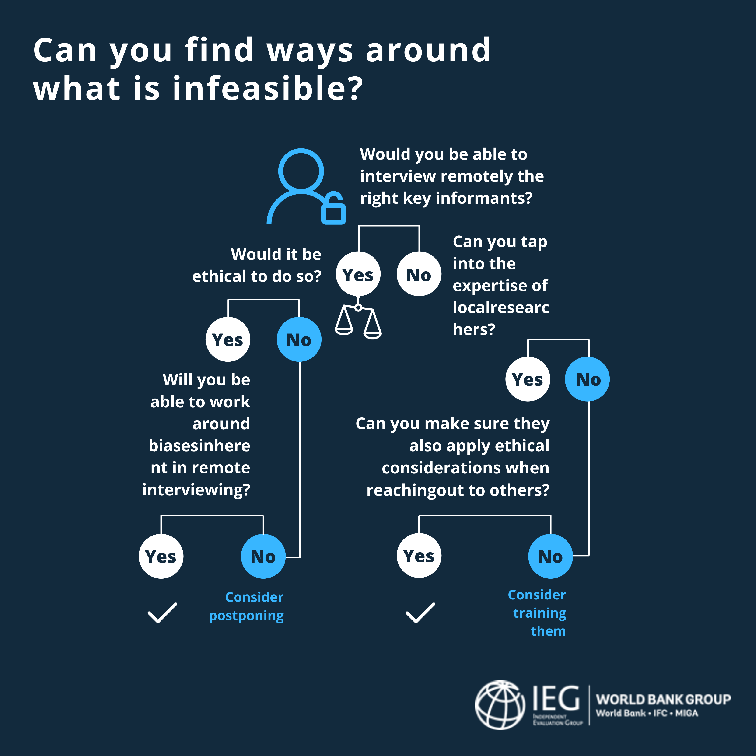
Remote interviewing
Local consultants
Ethical considerations
Mitigate biases

Slide 6
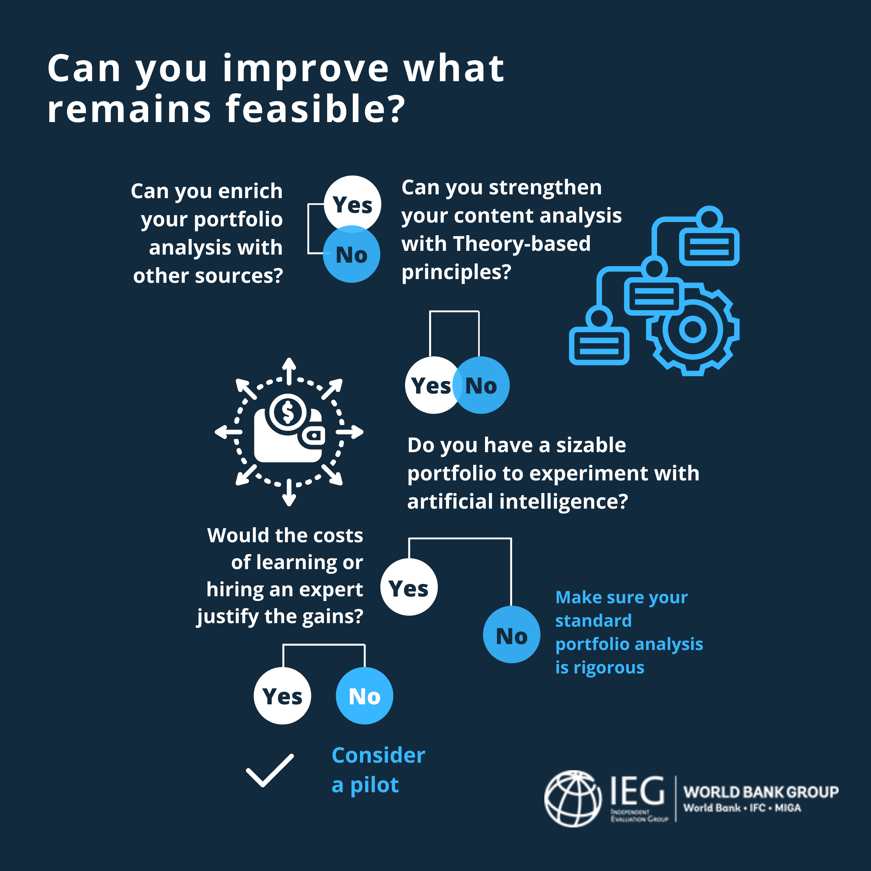
Enrich portfolio analysis
Conduct theory-based content analysis
Experiment with Artificial Intelligence
Remote interviewing
Local consultants
Ethical considerations
Mitigating biases

Slide 7
1. Evaluators as synthesizers: example private sector development projects evaluative synthesis
Source: IEG, Bravo

Slide 8
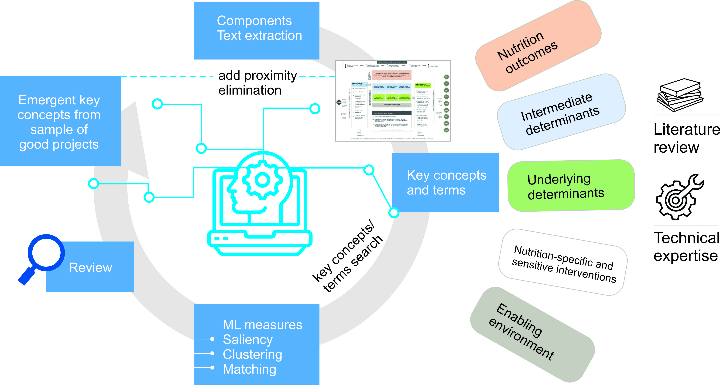
2. Identifying the evaluand: example global evaluation WBG support to combat undernutrition
Source: IEG, Gold and Vellez

Slide 9
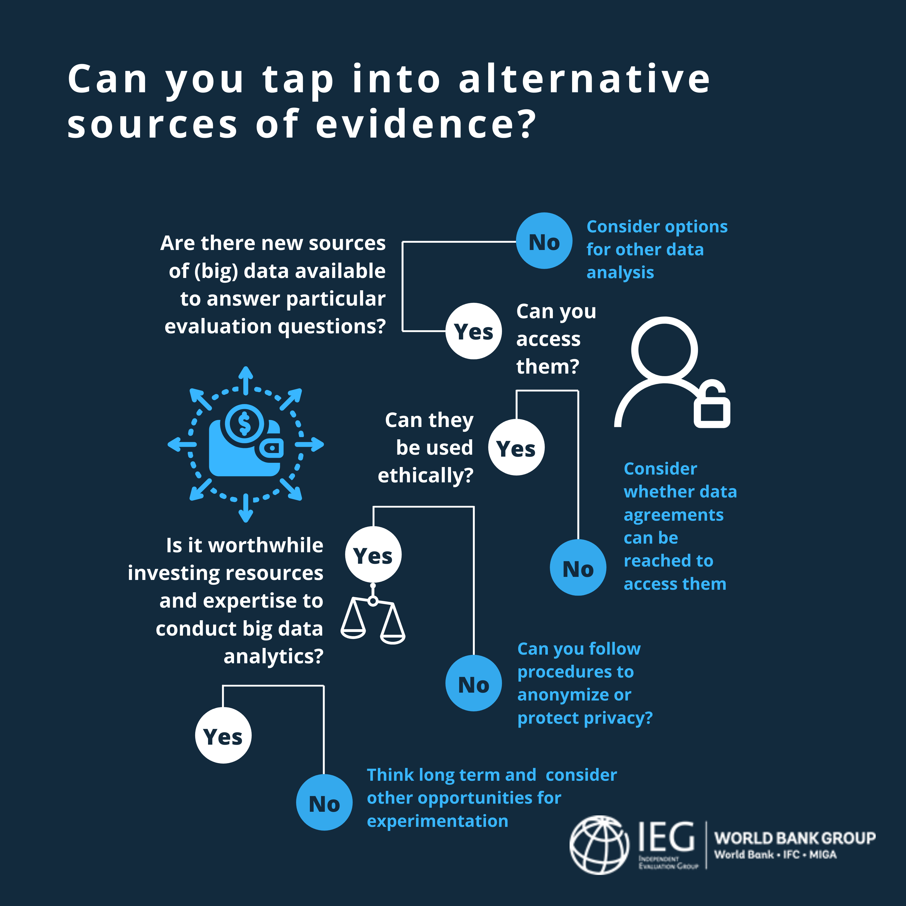
Explore new sources of (big) data

Slide 10
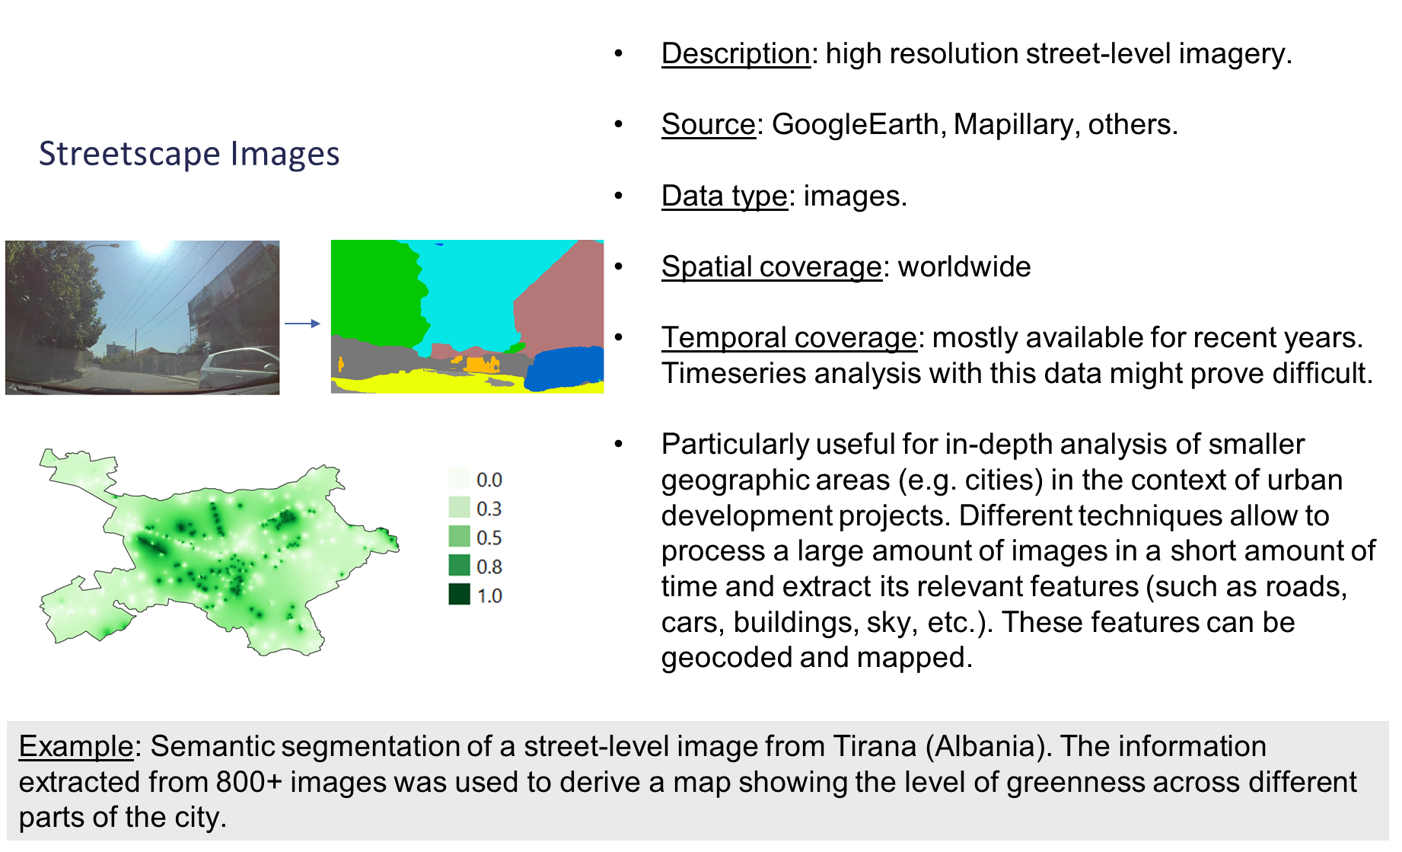
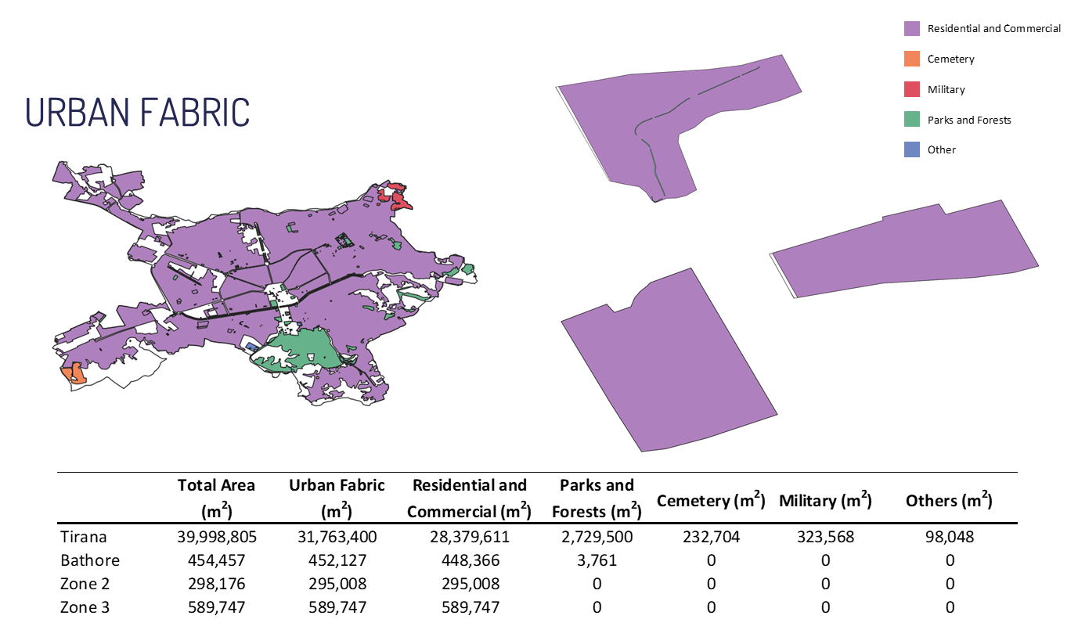
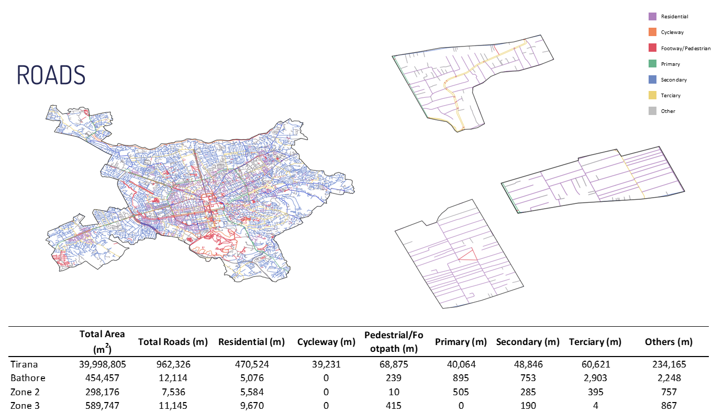
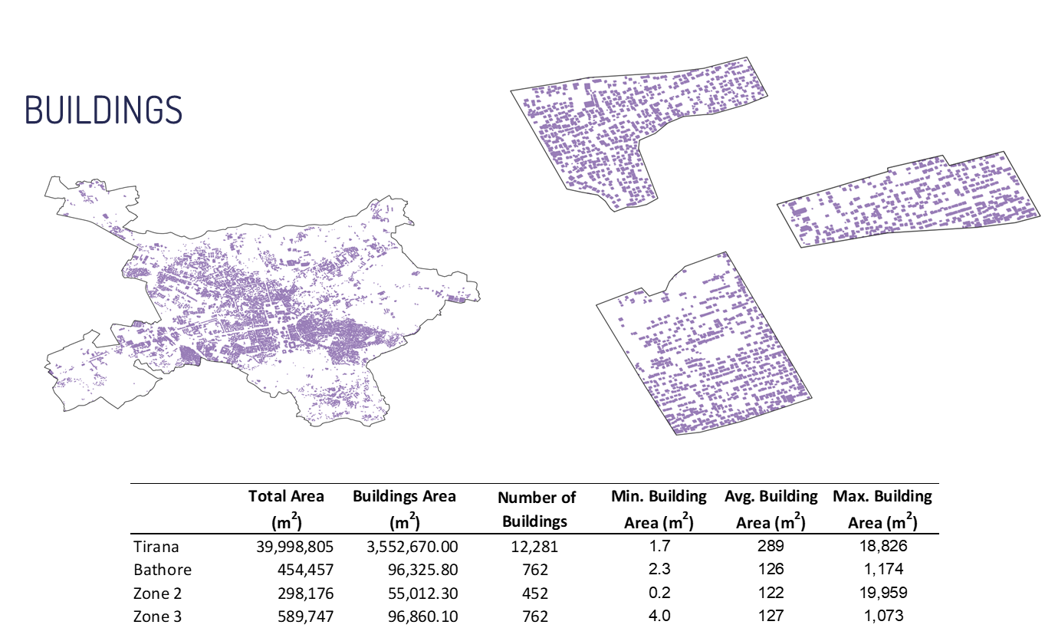
3. Using big data for evaluative analysis: example geospatial data Tirana (urban development)
Source: IEG, Ziulu

Slide 11
Going forward: what have we learned?
The role of evaluation
Methodological innovation: yes, but…
Organizing (independent) evaluation in international organizations

Slide 12
Thank you!

