Slide 1
Training processes to improve quality of evaluations.
21 de setiembre, 2017
Mainz, Alemania
Carolina Zúñiga
(Equipo Técnico FOCEVAL-Costa Rica)

Slide 2
Foceval project
The project Evaluation Capacity Development (Foceval), work with different instances in Latin America. In Costa Rica, we work closely with the Ministry of Planning witch has been a key institution in order to achieve Foceval's goals.

Slide 3
Foceval: 2017-2018
As we enter in the third phase of the project in 2017, we identify a list of different "challenges" to overcome in order to consolidate all the past actions undertaken in Costa Rica, and ensure the sustainability of the goals achieved.

Slide 4
Identified challenges
• Most trained professionals (with an evaluation Master Program) do not work in areas / departments related to the evaluation topic.
• Raising awareness and creating opportunities for young-emergent evaluator’s people to be involved in practice processes, in order to generate the respective needed skills to work in the evaluation area.
• It is still necessary that more evaluators or people interested in evaluation join the efforts to get organize and improve the representation of evaluators in the country and abroad.

Slide 5
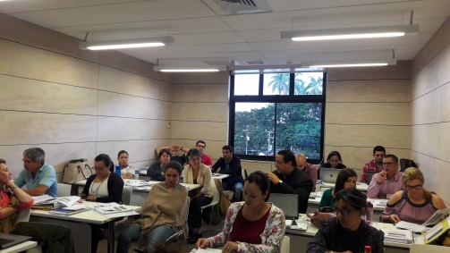
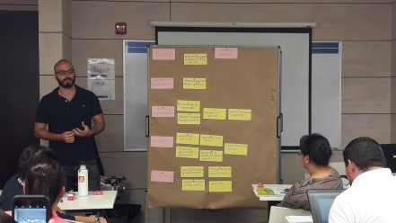
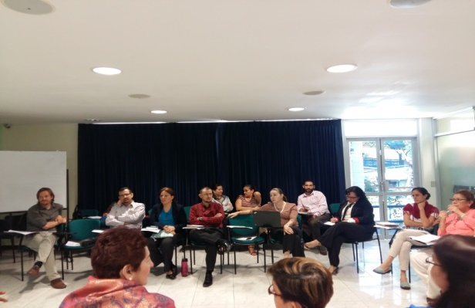
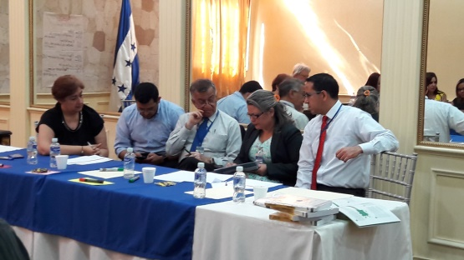
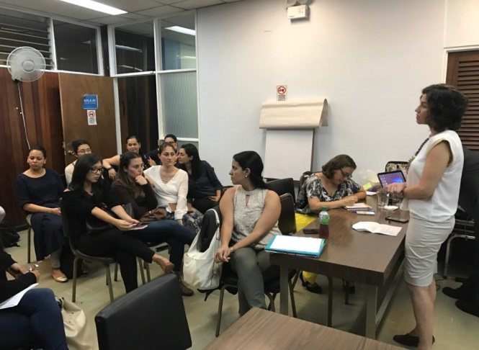
Different actions perform by Foceval
Traingings to public sector staff involved in evaluations, and open oportunities for Young and Emergent Evaluators.

Slide 6
Foceval trainings
Training with public staff | Training with YEE
Different courses in specific evaluation topics for the training of Evaluation and Planning Units of different institutions. | Specialized assessment courses have been sponsored.
Hiring of sponsors (evaluation experts) who have accompanied evaluation processes. | The inclusion of YEE in the evaluation team: Bridge to Development has been requested in TDR.
Evaluation management course to lower management public personnel | Involved as facilitators of training workshops.
“Learning by doing” processes to encourage practice in evaluation. | Support of an evaluation managed and executed by JEE.
 | Inclusion of YEE in both the National Platform and the Regional Platform of the project.

Slide 7
What we see in the future?
Both YEE and public officials become multipliers of training processes.
A higher demand for evaluations.
Those who demand evaluations integrate YEE.
To have better managed evaluations, with better TOR, better data
Evaluators organized, that can train other YEE, as well as advise other institutions in the evaluation topic.
A better quality evaluations.

Slide 8
DANKE!!!
Notes:
Tres casos.Explicar instrucciones.

